Slide 1
What is Insertion Sort?
Insertion sort is a sorting algorithm that places an unsorted element at its suitable place in each iteration.
The array is virtually split into a sorted and an unsorted part. Values from the unsorted part are picked and placed at the correct position in the sorted part.

Slide 2
Insertion Sort
2
5
4
1
3

Slide 3
Insertion Sort
2
5
4
1
3

Slide 4
Insertion Sort
2
5
4
1
3

Slide 5
Insertion Sort
2
4
5
1
3

Slide 6
Insertion Sort
1
2
4
5
3

Slide 7
Insertion Sort
1
2
3
4
5
Sorting Finished!

Slide 8
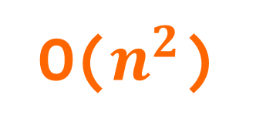
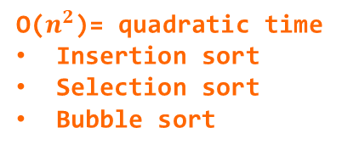
O($n^{2}$)
O(n log n)
O($n^{2}$)= quadratic time
Insertion sort
Selection sort
Bubble sort
O(n)
time
O(log n)
data

